Slide 1
Project to predict student grades based on given input features

Slide 2
Introduction
Assignment Overview:
This assignment focuses on building a regression model to predict student grades using a dataset of high school students in Montreal.
The analysis includes feature selection, regression techniques to enhance predictions.
Significance:
Understand key predictors of academic performance.

Slide 3
Objectives
Main Objectives:
Develop a predictive regression model for student grades.
Identify significant features influencing student performance using feature selection techniques.
Evaluate and compare the performance of different models to optimize results.

Slide 4
Dataset Description
Dataset Overview:
Contains information on students’ academic performance in Montreal high schools.
Includes various features related to student demographics, socio-economic factors, and academic metrics.
Some of the input factors include (School, Age, Address, Reason, Travel time, Study time, Activities, Free time, Health, Absences)
Our target values include first period grade (g1), second period grade (g2), final grade (g3)

Slide 5
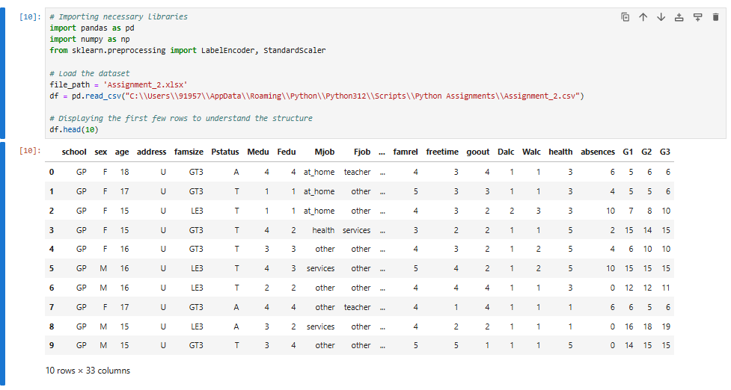
Displaying the first few rows to understand the structure of dataset

Slide 6
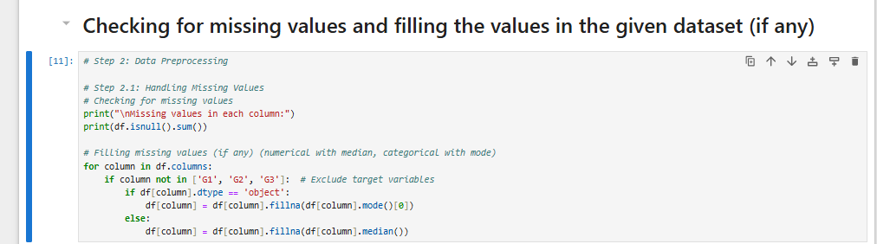
Checking for any missing values in the given dataset

Slide 7

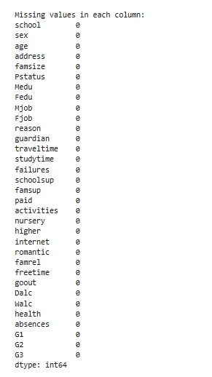
We can see that there are no missing values present in the given dataset, so need to fill values of any kind and we can use the given dataset for data preprocessing.

Slide 8
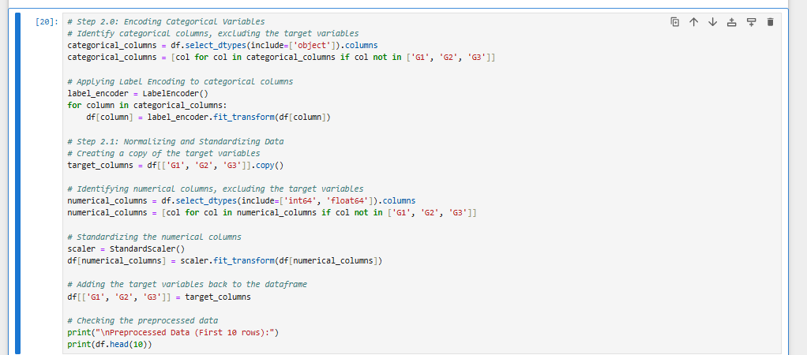
Data Preprocessing - Encoding Categorical Variables and Normalizing input factors

Slide 9
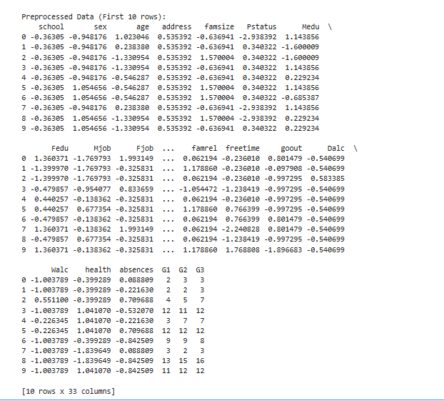

Slide 10
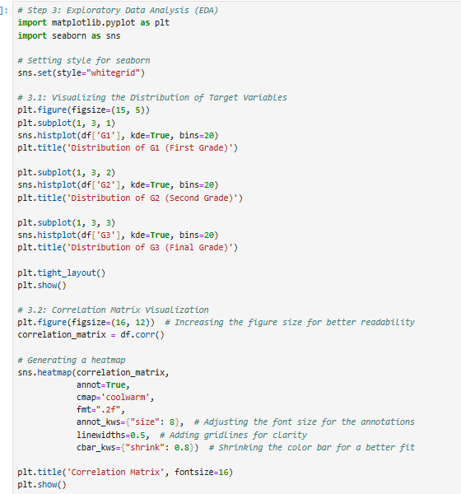
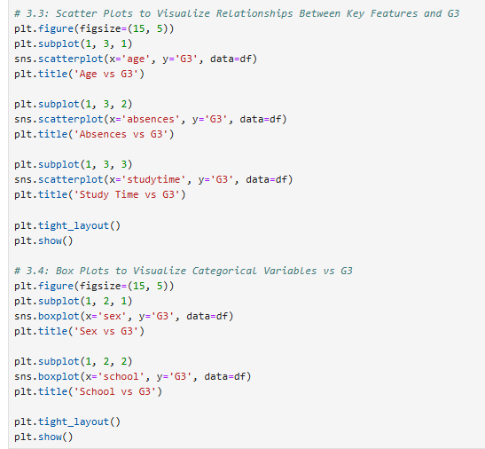
Exploratory Data Analysis

Slide 11
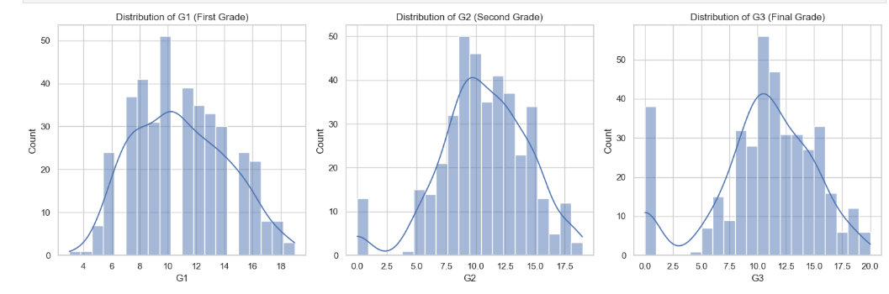

Slide 12
Insights from obtained graph
Uniform Distribution Trends: G1 (First Grade), G2 (Second Grade), and G3 (Final Grade) follow similar bell-shaped distributions with a central tendency around 10.
Progression Analysis: Grades become slightly dispersed as they move from G1 to G3, indicating variability in student performance over time.
Outliers Present: Extreme low or high grades (e.g., G3 = 0 or 20) are noticeable in the data.
Skewness and Mean: The data is roughly symmetrical for all three grades, aligning with a normal distribution pattern.

Slide 13
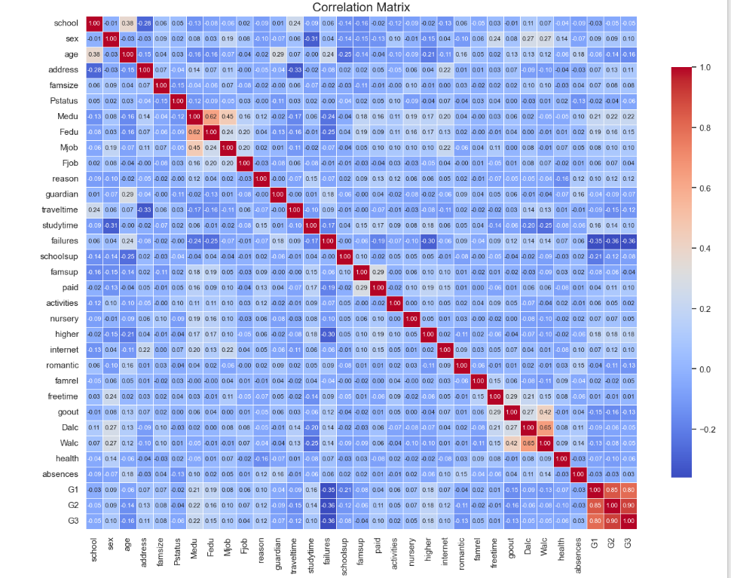

Slide 14
Insights from obtained graph
Strong Correlation Identified: G1, G2, and G3 grades show a very high positive correlation (0.8–0.9), suggesting interdependence.
Key Variables to Analyze: "Study Time," "Parental Education (Medu)," and "Absences" demonstrate moderate correlation with grades.
Parental Influence Notable: "Fedu" (Father's Education) and "Mjob" (Mother's Job) show mild correlations, highlighting their potential influence on academic outcomes.

Slide 15
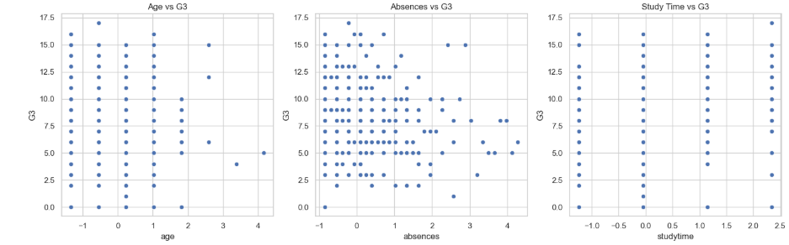
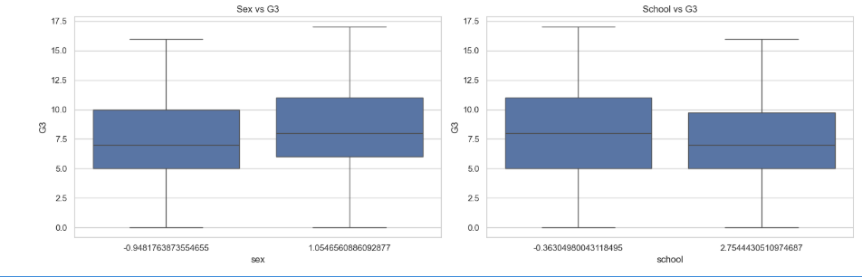
Residuals for some of the features against Final grade (g3)

Slide 16
Insights from obtained graphs
Sex vs G3: Both male and female students have a similar median final grade (G3), though females exhibit slightly higher performance on average.
School vs G3: Differences between schools are negligible, with both showing comparable grade distributions and similar medians.
Consistency Across Groups: Box plots highlight that variations in grades are largely consistent across sexes and schools, with minimal disparity.

Slide 17
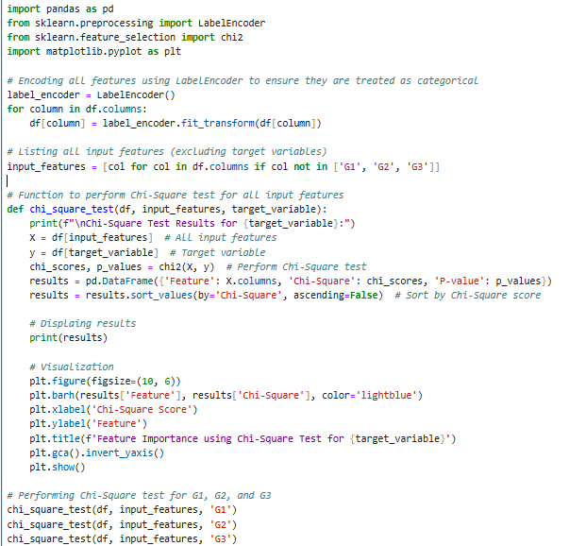
Performing Chi Square tests to identify important features for g1, g2, g3

Slide 18
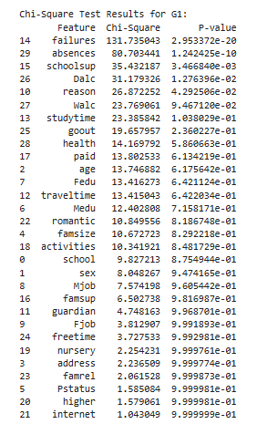
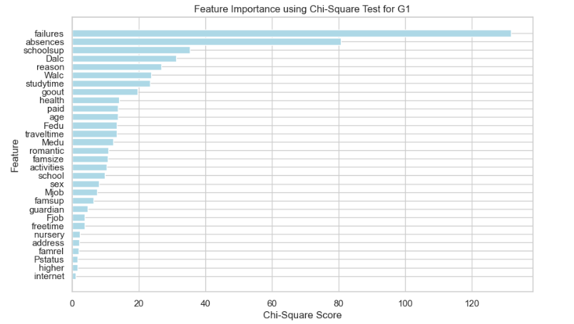

Slide 19
Insights from obtained graph for g1
Top Contributing Features: "Failures," "Absences," and "School Support (schoolsup)" have the highest Chi-Square scores, indicating their significant impact on G1 performance.
Moderately Important Features: Alcohol consumption ("Dalc"), study time, and "Reason" (why the student chose the school) show moderate relevance.
Low Impact Features: Variables like "Internet Access," "Higher Education Aspiration," and "Pstatus" (parental cohabitation status) exhibit minimal impact on G1 grades.

Slide 20
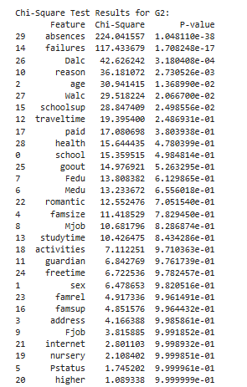
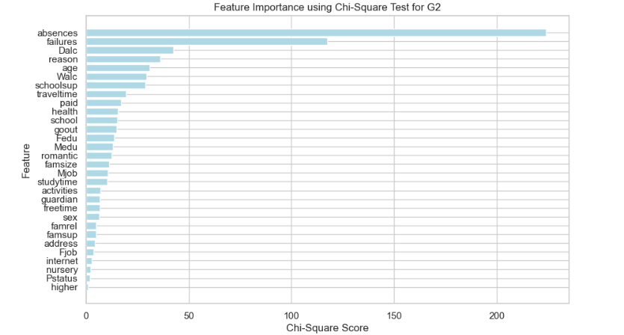

Slide 21
Insights from obtained graph for g2
Key Influencers: "Absences" and "Failures" dominate as the most significant predictors of G2 performance, with very high Chi-Square scores.
Moderately Relevant Features: Alcohol consumption ("Dalc"), "Reason" for school choice, and "Age" show moderate importance in influencing grades.
Minimal Impact Features: Variables such as "Internet Access," "Nursery Attendance," and "Pstatus" (parental cohabitation) have negligible influence on G2 grades.

Slide 22
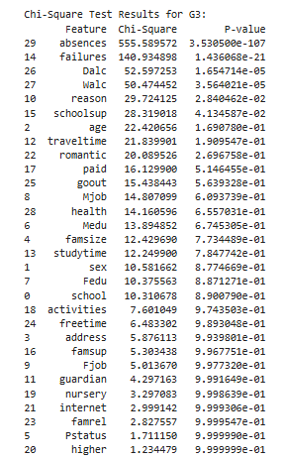
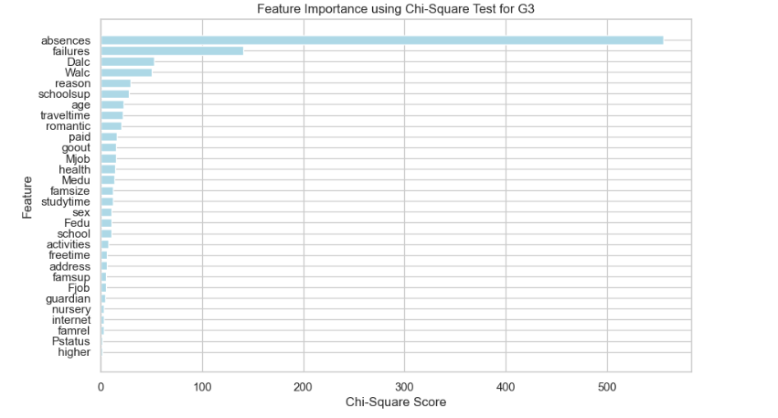

Slide 23
Insights from obtained graph for g3
Most Influential Features: "Absences" and "Failures" continue to be the strongest predictors of final grades (G3), with exceptionally high Chi-Square scores.
Significant Contributors: Alcohol consumption ("Dalc"), weekend alcohol use ("Walc"), and "Reason" for choosing the school show moderate importance.
Less Relevant Variables: Factors such as "Higher Education Aspiration," "Pstatus," and "Internet Access" have negligible influence on G3.

Slide 24
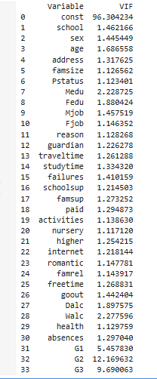
Checking for multicollinearity in the input factors and removing them if any found with multicollinearity

Slide 25
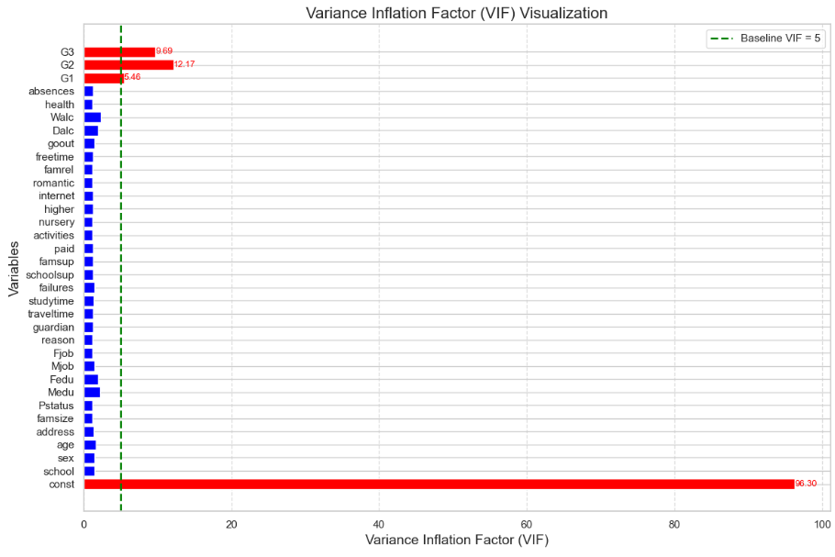

Slide 26
Insights from obtained results
High Multicollinearity:
Constant (const): Extremely high VIF (96.3), but this is expected as it is used as a baseline in the model and does not affect performance.
Target Variables (G1, G2, G3):
G2 has a VIF of 12.17, indicating strong multicollinearity with other features.
G3 has a VIF of 9.69, which is borderline high.
G1 also shows a VIF of 5.46, suggesting notable multicollinearity.
Since these are target variables, multicollinearity will not be affected.
Low Multicollinearity Among Input Variables:
Most other predictors have VIF values below 2.5, which indicates low to negligible multicollinearity.
Exceptions include: Medu (2.23) and Walc (2.28) show slightly elevated VIF values but remain acceptable.

Slide 27
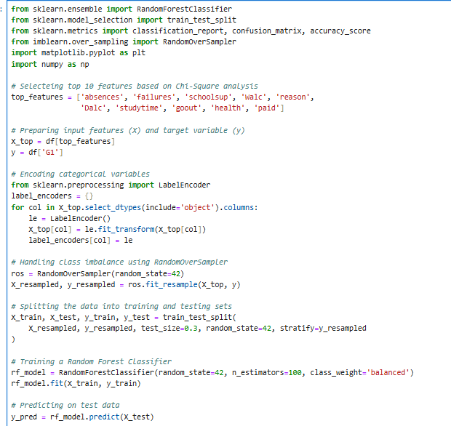
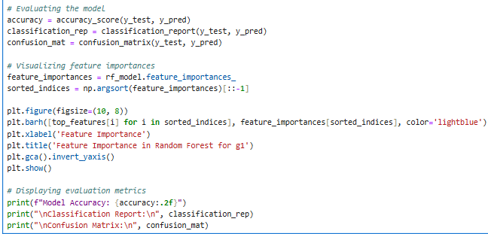
Treating target variable (g1) as a categorical variable and modelling a classification model

Slide 28
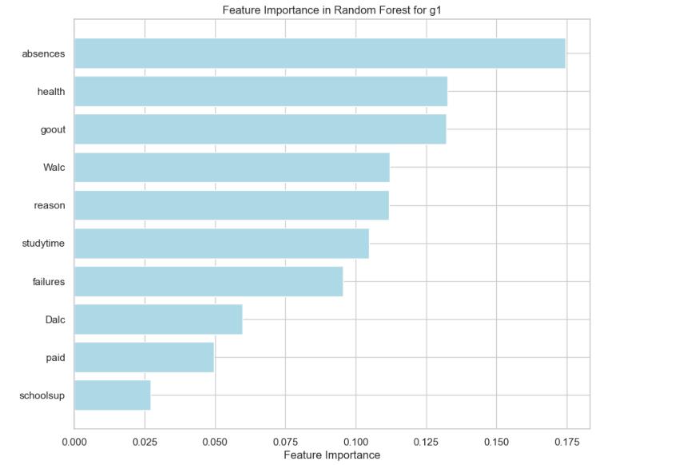

Slide 29
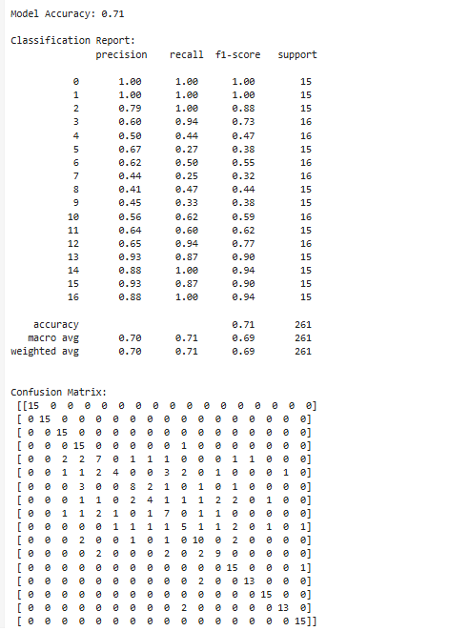

Slide 30
Insights from obtained results
Feature Importance in Random Forest for G1:
Top Features: "Absences" and "Health" are the most influential variables in predicting G1 performance.
Moderate Predictors: "Going out with friends (goout)," weekend alcohol consumption ("Walc"), and study time show moderate relevance.
Model Evaluation:
Accuracy: The model achieved an accuracy of 71%, indicating acceptable performance.
Classification Metrics:
Precision, recall, and F1-scores vary across classes, with better performance observed in well-represented categories (e.g., Class 0, Class 16).
Macro and weighted averages for precision, recall, and F1-scores are consistent (~70-71%).
Confusion Matrix: Clearly identifies areas where predictions are accurate (diagonal) and where misclassifications occur and with more data, model can be refined.

Slide 31
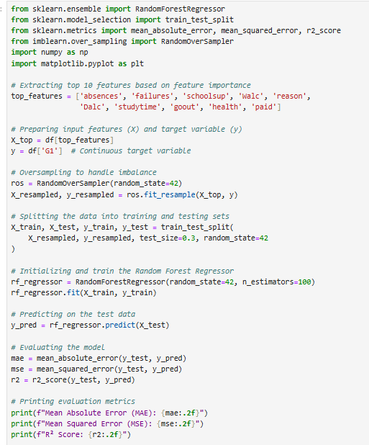
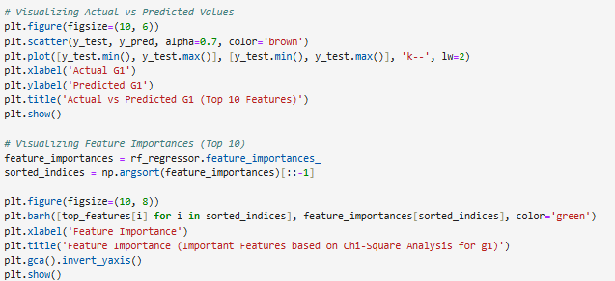
Treating target variable (g1) as a continuous variable and modelling a regression model

Slide 32
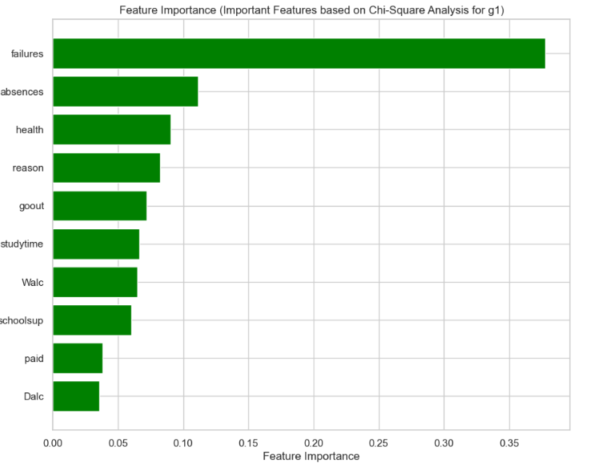

Slide 33
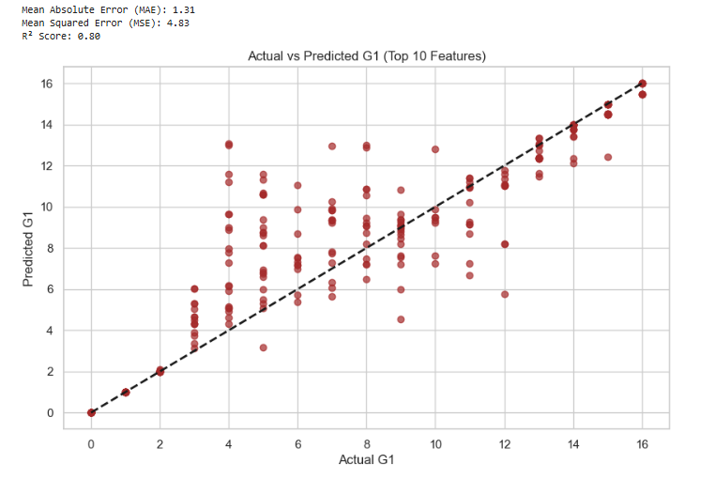

Slide 34
Insights from obtained results
Key Metrics: Achieved an MAE of 1.31, MSE of 4.83, and R² score of 0.80, indicating good predictive accuracy.
Actual vs Predicted Plot: The scatter plot illustrates strong alignment along the diagonal, suggesting reliable predictions.
Feature Importance Visualization: "Failures" and "Absences" emerged as the most critical predictors, with other features like "health" and "study time" contributing moderately.

Slide 35
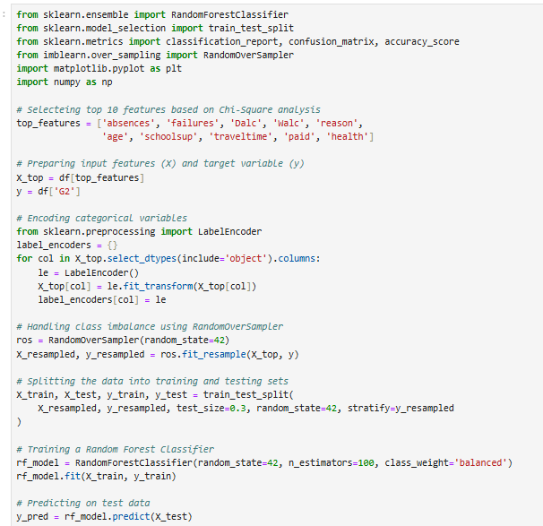
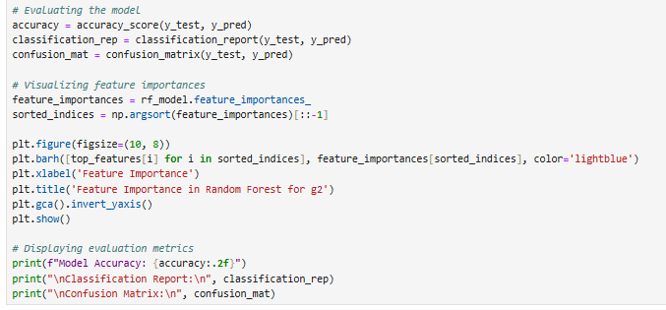
Treating target variable (g2) as a categorical variable and modelling a classification model

Slide 36
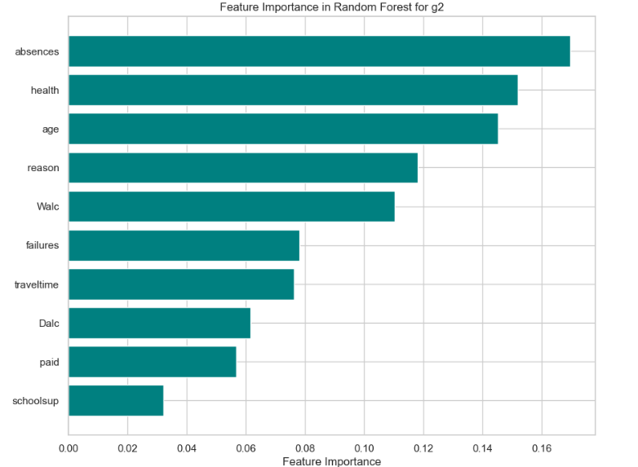

Slide 37
Insights from obtained graph
Feature Importance in Random Forest:
The top three most influential features for predicting g2 include absences, health, and age.
Other significant factors include reason, Walc (weekday alcohol consumption), and failures (previous academic failures).
Features like travel time, Dalc (weekend alcohol consumption), and schoolsup (extra support) had comparatively lower importance.

Slide 38
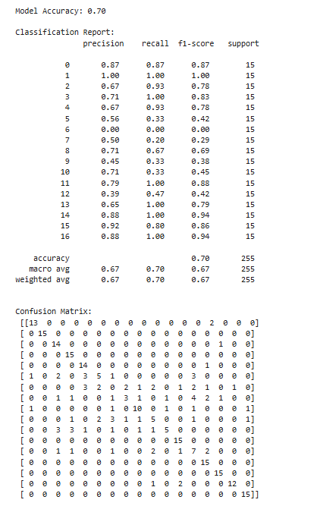

Slide 39
Insights from obtained results
Model Performance (Classification Report):
The Random Forest model achieved an overall accuracy of 70%.
Precision, recall, and F1 scores varied across different categories, with some labels performing well (e.g., label 1 with 100% precision and recall).
Macro-average and weighted average scores for precision, recall, and F1 are all 0.67, indicating balanced performance across categories.
Confusion Matrix Insights:
The confusion matrix highlights accurate predictions for most categories, with some misclassifications.
A notable number of predictions are concentrated on correct diagonal values, reflecting a reliable classification process.
The model demonstrates strong potential, with key insights drawn from feature importance analysis.

Slide 40
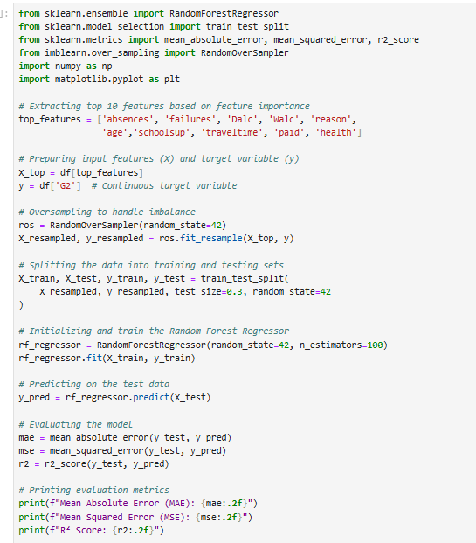
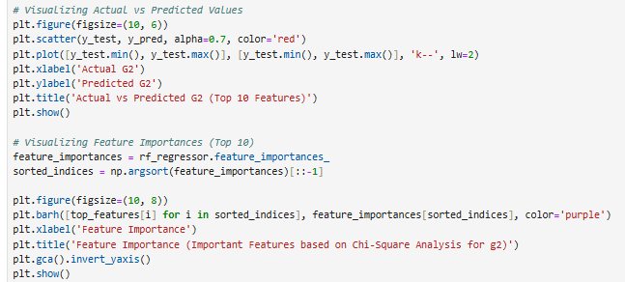
Treating target variable (g2) as a continuous variable and modelling a regression model

Slide 41
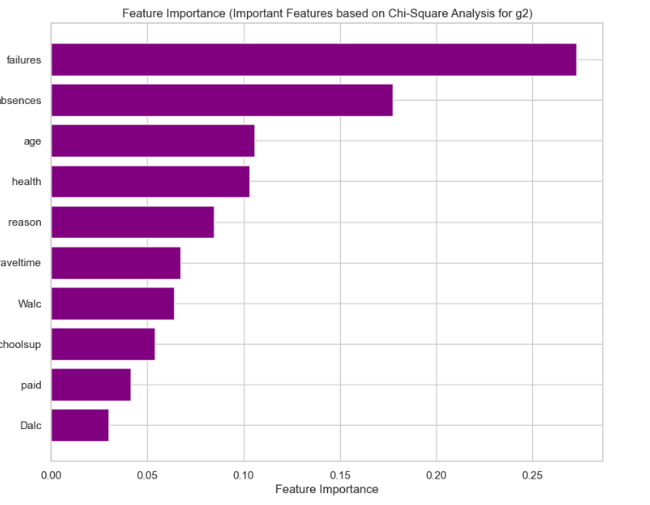

Slide 42
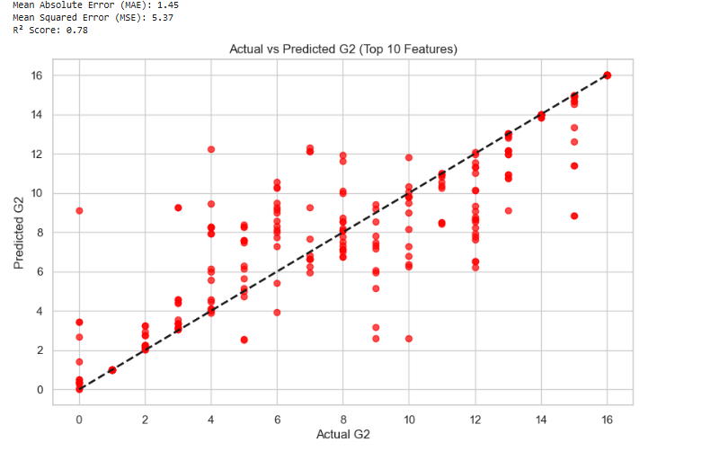

Slide 43
Insights from obtained results
Top Features:
Key features influencing g2 include failures, absences, age, and health.
Features like reason and travel time also contributed but to a lesser extent.
Walc, schoolsup, and Dalc were among the least impactful but still relevant.
Error Metrics:
Mean Absolute Error (MAE): 1.45
Mean Squared Error (MSE): 5.37
R² Score: 0.78, indicating a strong fit but with room for refinement.
Scatter Plot (Actual vs Predicted):
Most predictions align closely with the diagonal line, reflecting accuracy.
Outliers indicate areas for improvement in model prediction, potentially linked to underrepresented features or noise.
The regression model effectively captures key trends in student performance but could benefit from additional data in relevant categories for improvement in accuracy.

Slide 44
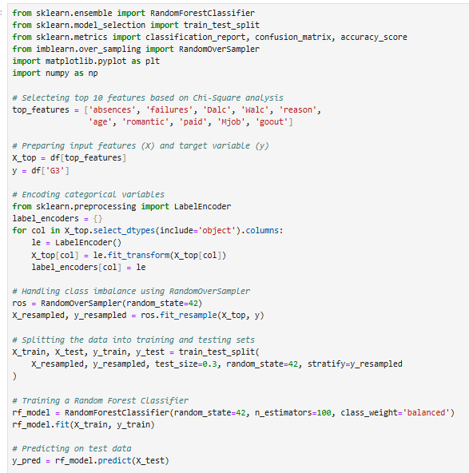
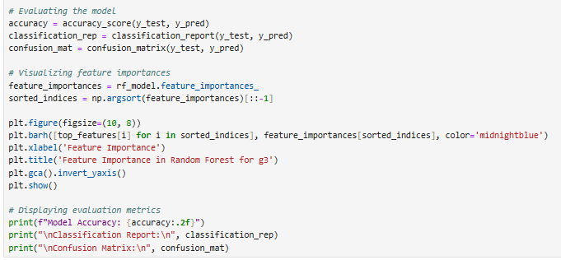
Treating target variable (g3) as a categorical variable and modelling a classification model

Slide 45
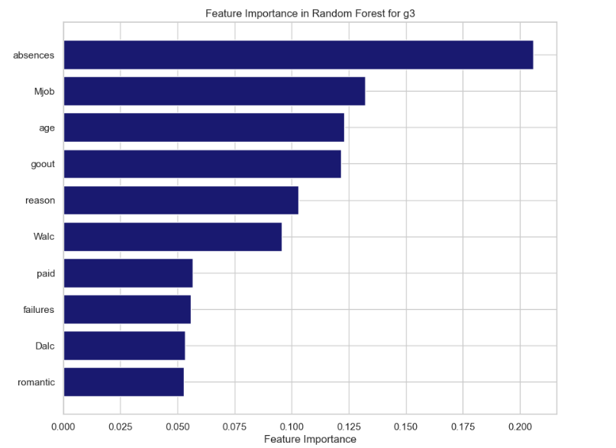

Slide 46
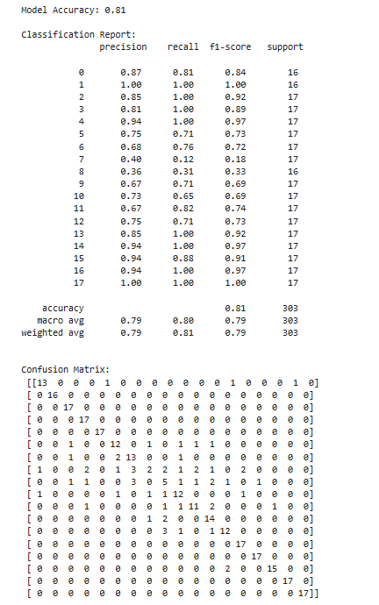

Slide 47
Insights from obtained results
Top Features:
The most impactful feature for predicting g3 is absences, followed by Mjob (mother's job), age, and goout (social outing frequency).
Other relevant features include reason, Walc (weekday alcohol consumption), and failures.
Model Accuracy:
Achieved an accuracy of 81%, indicating strong predictive capability.
Macro-average and weighted-average precision, recall, and F1 scores are approximately 0.79, reflecting balanced classification performance.
Classification Report Highlights:
Categories like 0 and 1 show perfect precision and recall, while others, such as 7 and 8, exhibit weaker performance (precision < 0.5).
Confusion Matrix Insights:
Majority of predictions align with correct classes, evident from the diagonal dominance.
Misclassifications are minimal but observed in certain labels like 7 and 8.
Behavioral and demographic factors significantly influence g3.
Model accuracy of 81% demonstrates robustness but highlights potential for further tuning to improve underperforming categories.

Slide 48
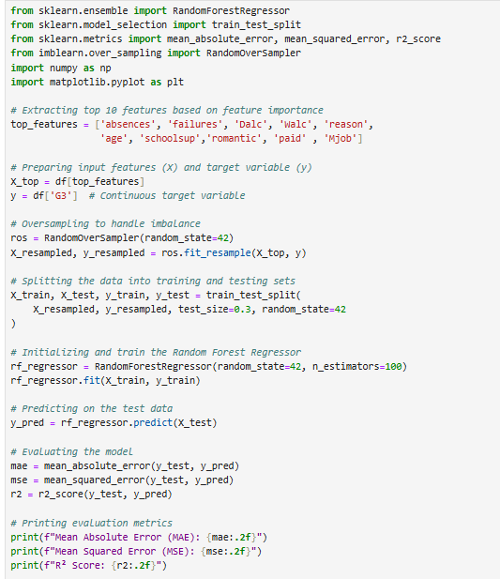
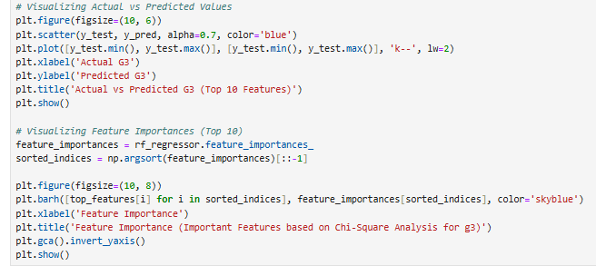
Treating target variable (g3) as a continuous variable and modelling a regression model

Slide 49
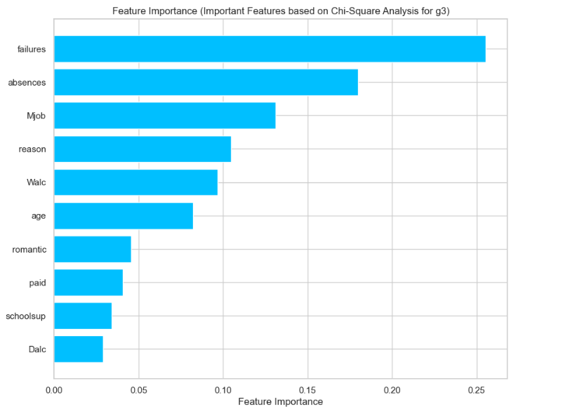

Slide 50
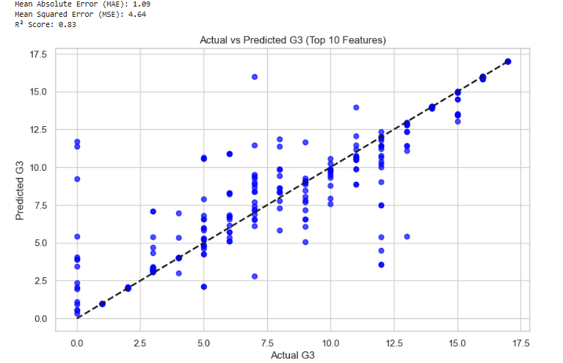

Slide 51
Insights from obtained results
Top Features:
Failures is the most significant feature for predicting g3, followed by absences, Mjob (mother's job), and reason.
Other influential features include Walc (weekday alcohol consumption), age, and romantic (romantic relationships).
Error Metrics:
Mean Absolute Error (MAE): 1.09
Mean Squared Error (MSE): 4.64
R² Score: 0.83, indicating a high degree of predictive accuracy.
Scatter Plot Analysis (Actual vs. Predicted g3):
Most predictions align closely with the diagonal line, showing strong model performance.
A few outliers are present, suggesting some inconsistencies or underrepresentation of key features.
Key Findings:
Academic and behavioral attributes like failures, absences, and parental job role significantly influence final student grades.
The model’s high R² score of 0.83 and low MAE demonstrate robust predictive accuracy.

Slide 52
Conclusion
Grade Target | Model Type | Top Features | Performance Metrics
G1 | Categorical | Absences, Health, Goout, Walc, Study Time | Accuracy: 71%, Macro F1: 70%
G1 | Regression | Failures, Absences, Health, Reason, Goout | MAE: 1.31, MSE: 4.83, RÂ²: 0.80
G2 | Categorical | Absences, Health, Age, Reason, Walc, Failures | Accuracy: 70%, Macro F1: 67%
G2 | Regression | Failures, Absences, Age, Health, Reason | MAE: 1.45, MSE: 5.37, RÂ²: 0.78
G3 | Categorical | Absences, Mjob, Age, Goout, Reason, Walc | Accuracy: 81%, Macro F1: 79%
G3 | Regression | Failures, Absences, Mjob, Reason, Walc, Age, romantic | MAE: 1.09, MSE: 4.64, RÂ²: 0.83

Slide 53
Conclusion
Significant Predictors: Across all grade targets (G1, G2, G3), absences and failures consistently emerged as the most critical features influencing student performance, alongside behavioral and demographic factors like health, age, and parental roles.
Model Performance: Both classification and regression models demonstrated reliable performance, with the regression models achieving high R² scores (up to 0.83) and classification models delivering balanced precision and recall metrics.
Categorical Models: The classification models effectively categorized student grades, with G3 achieving the highest accuracy of 81%, indicating robustness in predicting final grades.
Regression Models: Regression models showed strong alignment between predicted and actual grades, as evidenced by low MAE values (e.g., 1.09 for G3) and strong R² values, showcasing their utility in capturing grade trends.
Feature Insights: Feature importance analysis highlighted the interplay of academic (e.g., failures, absences), behavioral (e.g., alcohol consumption, social outings), and demographic (e.g., parental education) factors in determining student success.
Future Improvements: To enhance model accuracy and generalizability, future steps could include expanding the dataset, addressing outliers through targeted preprocessing.

Slide 54
Thank you

